Slide 1
GraSPI
Graph-based Structure-Property Identifier
5 phase morphologies
Last updated on March 2023

Slide 2
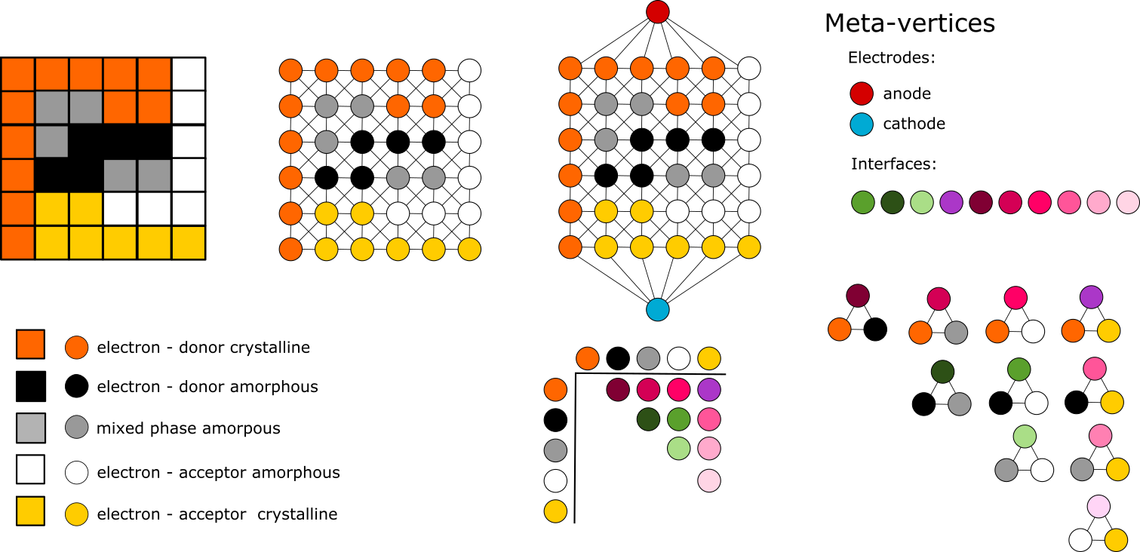
Morphology to graph transformation
Microstructure
Graph
Steps involved:
For each voxel in the microstructure image create vertex in graph
Connect vertices in the graph following neighborhood of the image (first and second order neighbors)

Slide 3
Morphology to graph transformation
Microstructure
Graph
Steps involved:
For top an bottom layers of the morphology, add the edges with the meta-vertices
Similar for the interface meta-vertices, add extra edges with the interface-type of meta vertex. Here Black-White-Green

Slide 4
Morphology to graph transformation
Microstructure
Graph
Steps involved:
And all other combinations of interface meta-vertices: DGreen, LGreen, Purple, Lpink, LLPink, LLPink, Dpink, DDPink, DDPink.

Slide 5
Graph-based representation is flexible to define and compute wide range of descriptors
Filter graph
Query filtered graph
Using standard graph-based algorithms
connected component algorithm
Shortest path
Microstructure
Graph={V,E}
Steps involved:
For each voxel in the microstructure image create vertex in graph
Connect vertices in the graph following neighborhood of the image (first and second order neighbors)
Filter graph and query the graph

Slide 6
Graph-based representation is flexible to define and extend towards 5 phase morphologies
Compute all distances
from black pixels to the interface (green meta vertex)
Compute histograms
Represent microstructure as a graph and add meta vertices
Filter graph
Make graph query:
Find shortest paths from
green vertex to all black vertices
Simple post processing Make queries to extract more specific descriptors
std::pair<double,double> F_DISS = wf_diss(G,d_g,C,W,vCC,CC,Ld,filename,wfilename,BLACK,GREEN);
std::pair<double,double> F_DISS_cr = wf_diss(G,d_g,C,W,vCC,CC,Ld,filename,wfilename,ORANGE,PURPLE);

Slide 7
Simple example

Slide 8
Input: two accepted formats
6 6 0
5 7 7 7 7 7
5 7 7 1 1 1
5 0 0 3 3 1
5 3 0 0 0 1
5 3 3 5 5 1
5 5 5 5 5 1
Array:
nx ny nz
[array of labels: size nx*ny*nz ]
We use a row-wise order to store the matrix of pixels/vertices.
Also, note the first pixels/voxels correspond to the most bottom left corner.
The first row of data is connected to BLUE meta-vertex (cathode).
The last row of data is connected to RED meta-vertex (anode).

Slide 9
ABS_f_D 0.472222
ABS_f_M 0.294118
CT_f_conn 0.666667
CT_f_conn_A_Ca 0.5
CT_f_conn_DM_An 0.545455
CT_f_conn_D_An 0.705882
DISS_f10_D 1
DISS_f10_Dcr 1
DISS_wf10_D 0.858292
DISS_wf10_Dcr 0.587179
STAT_CC_A 1
STAT_CC_A_Ca 0
STAT_CC_Acr 1
STAT_CC_Acr_Ca 1
STAT_CC_D 1
STAT_CC_D_An 0
STAT_CC_Dcr 1
STAT_CC_Dcr_An 1
STAT_CC_M 2
STAT_CC_M_An 0
STAT_CC_M_AnCa 2
STAT_CC_M_Ca 0
STAT_n 36
STAT_n_A 7
STAT_n_Acr 7
STAT_n_D 5
STAT_n_Dcr 12
STAT_n_M 5
DistancesBlackToGreen.txt
1.70711
0.707107
1.70711
1.5
0.5
DistancesOrangeToPurple.txt
0.5
0.5
0.707107
1.70711
2.70711
6.53553
7.53553
3.70711
4.12132
5.12132
6.12132
7.12132

Slide 10
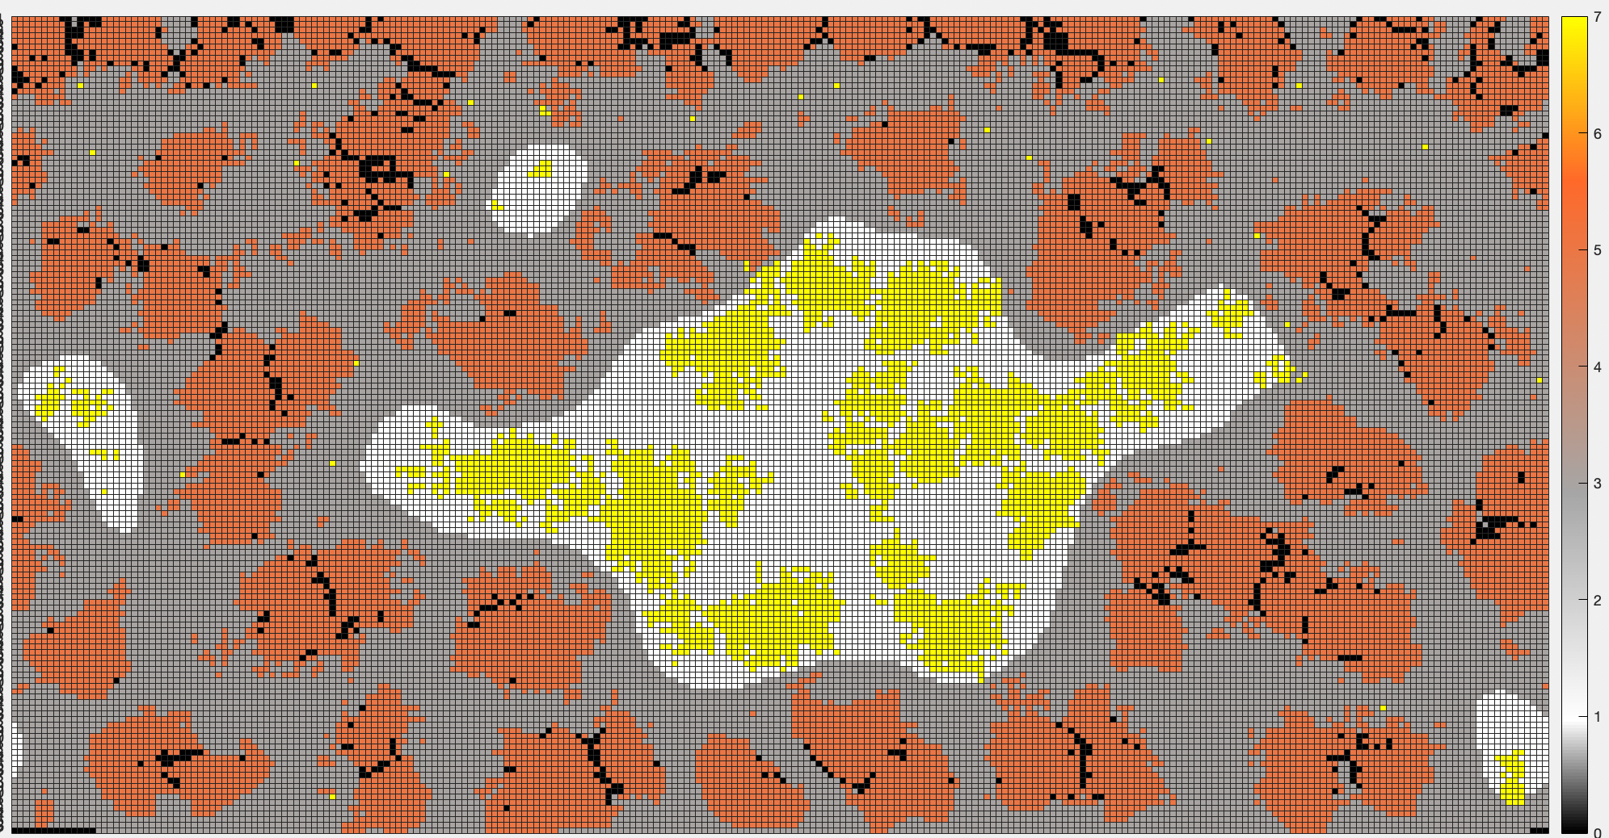
Example of usage
Go to folder folder examples/5phaseMorphologies/HIERN Input: set of morphologies in the array format
Execute script RunTests.sh Outcome: set of descriptors in log file and set of files with distances
Execute script PrepareReport.sh
Outcome: pdf with the report.
Source: see folder examples/5phaseMorphologies/HIERN

Slide 11
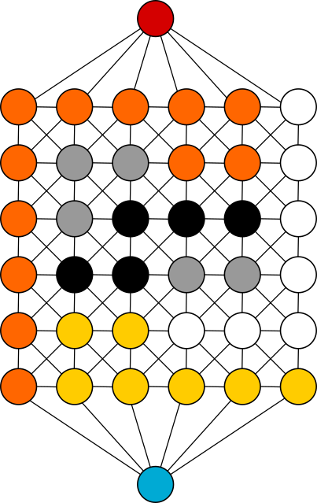
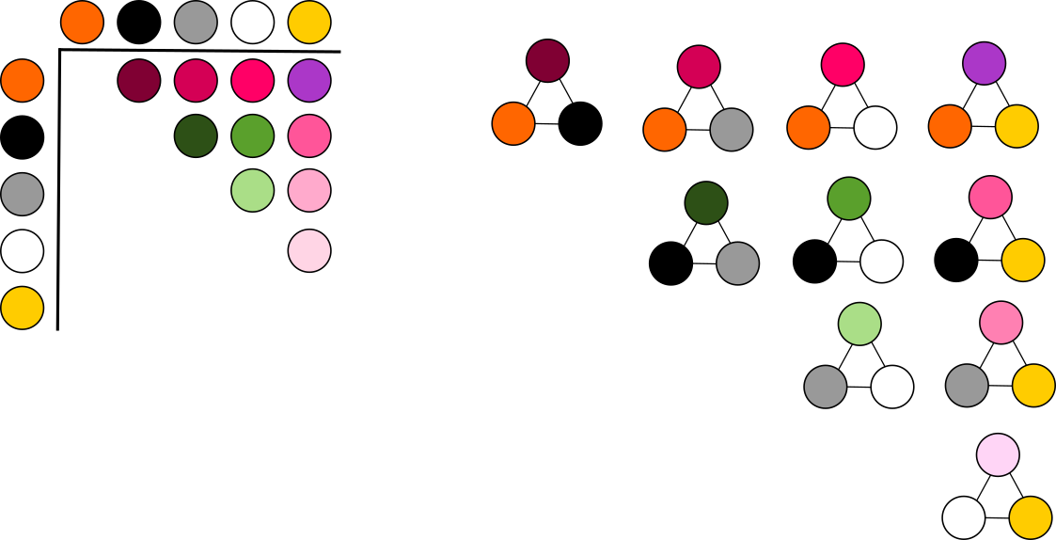
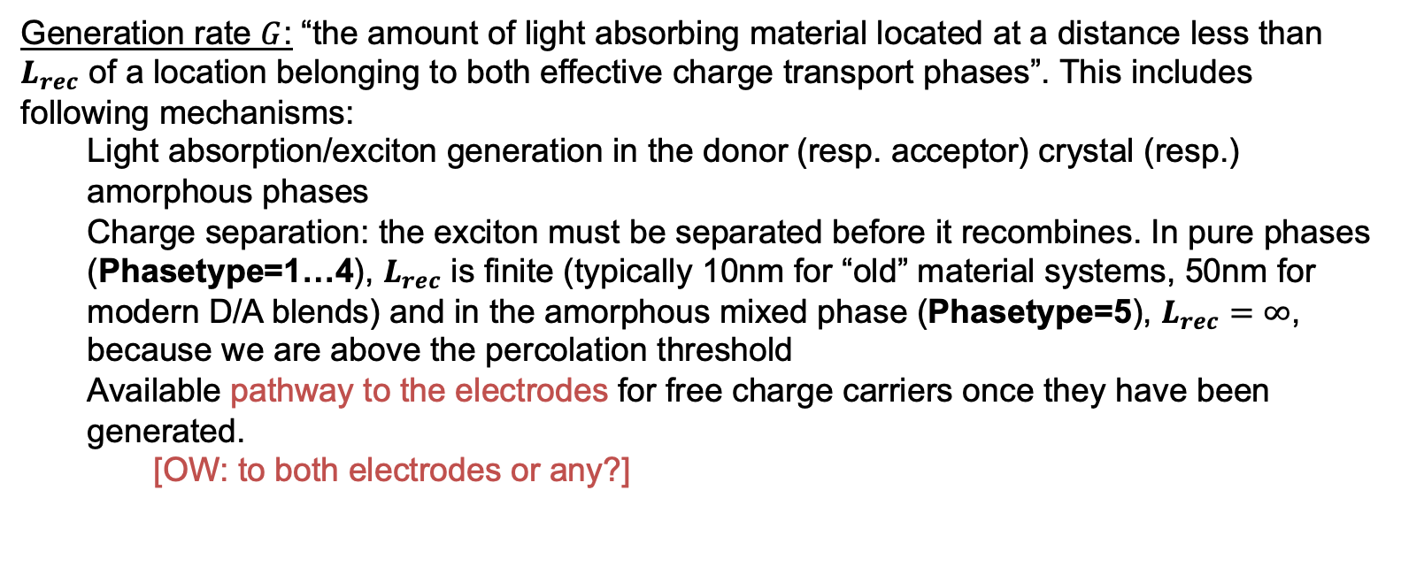
Translate descriptors to graph characteristics
Generation rate $G$: “the amount of light absorbing material located at a distance less than $L_{rec}$ of a location belonging to both effective charge transport phases”. This includes following mechanisms:
Light absorption/exciton generation in the donor (resp. acceptor) crystal (resp.) amorphous phases
Charge separation: the exciton must be separated before it recombines. In pure phases (Phasetype=1…4), $L_{rec}$ is finite (typically 10nm for “old” material systems, 50nm for modern D/A blends) and in the amorphous mixed phase (Phasetype=5), $L_{rec}=∞$, because we are above the percolation threshold
Available pathway to the electrodes for free charge carriers once they have been generated.
[OW: to both electrodes or any?]
DistancesBlackToGreen
DistancesOrangeToPurple

Slide 12
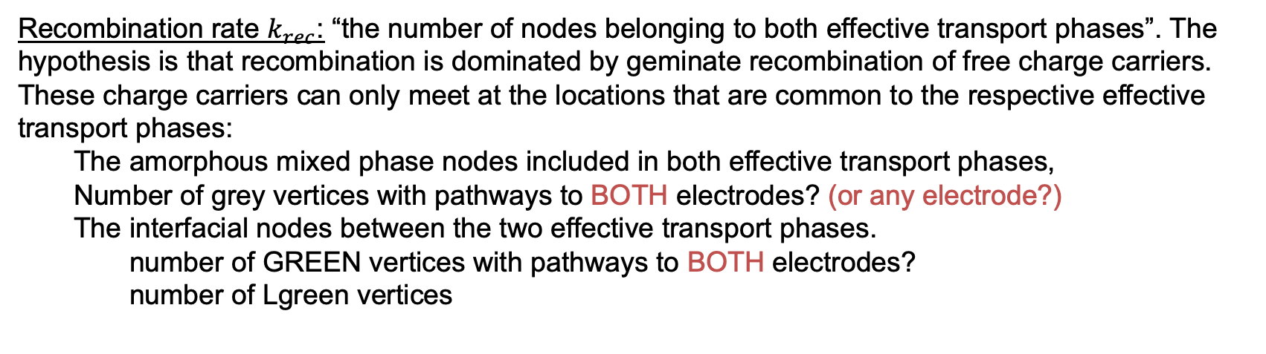
Translate descriptors to graph characteristics
Recombination rate $k_{rec}$: “the number of nodes belonging to both effective transport phases”. The hypothesis is that recombination is dominated by geminate recombination of free charge carriers. These charge carriers can only meet at the locations that are common to the respective effective transport phases:
The amorphous mixed phase nodes included in both effective transport phases,
Number of grey vertices with pathways to BOTH electrodes? (or any electrode?)
The interfacial nodes between the two effective transport phases.
number of GREEN vertices with pathways to BOTH electrodes?
number of Lgreen vertices

Slide 13
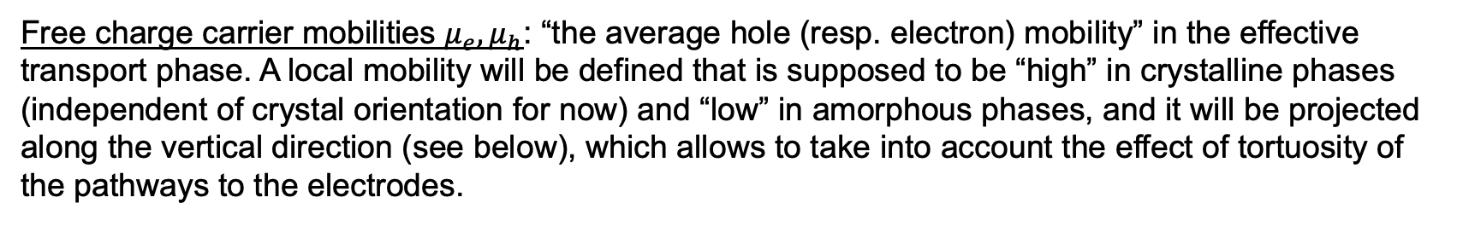
Translate descriptors to graph characteristics
Free charge carrier mobilities $μ_{e},μ_{h}$: “the average hole (resp. electron) mobility” in the effective transport phase. A local mobility will be defined that is supposed to be “high” in crystalline phases (independent of crystal orientation for now) and “low” in amorphous phases, and it will be projected along the vertical direction (see below), which allows to take into account the effect of tortuosity of the pathways to the electrodes.
TODO

